Slide 1
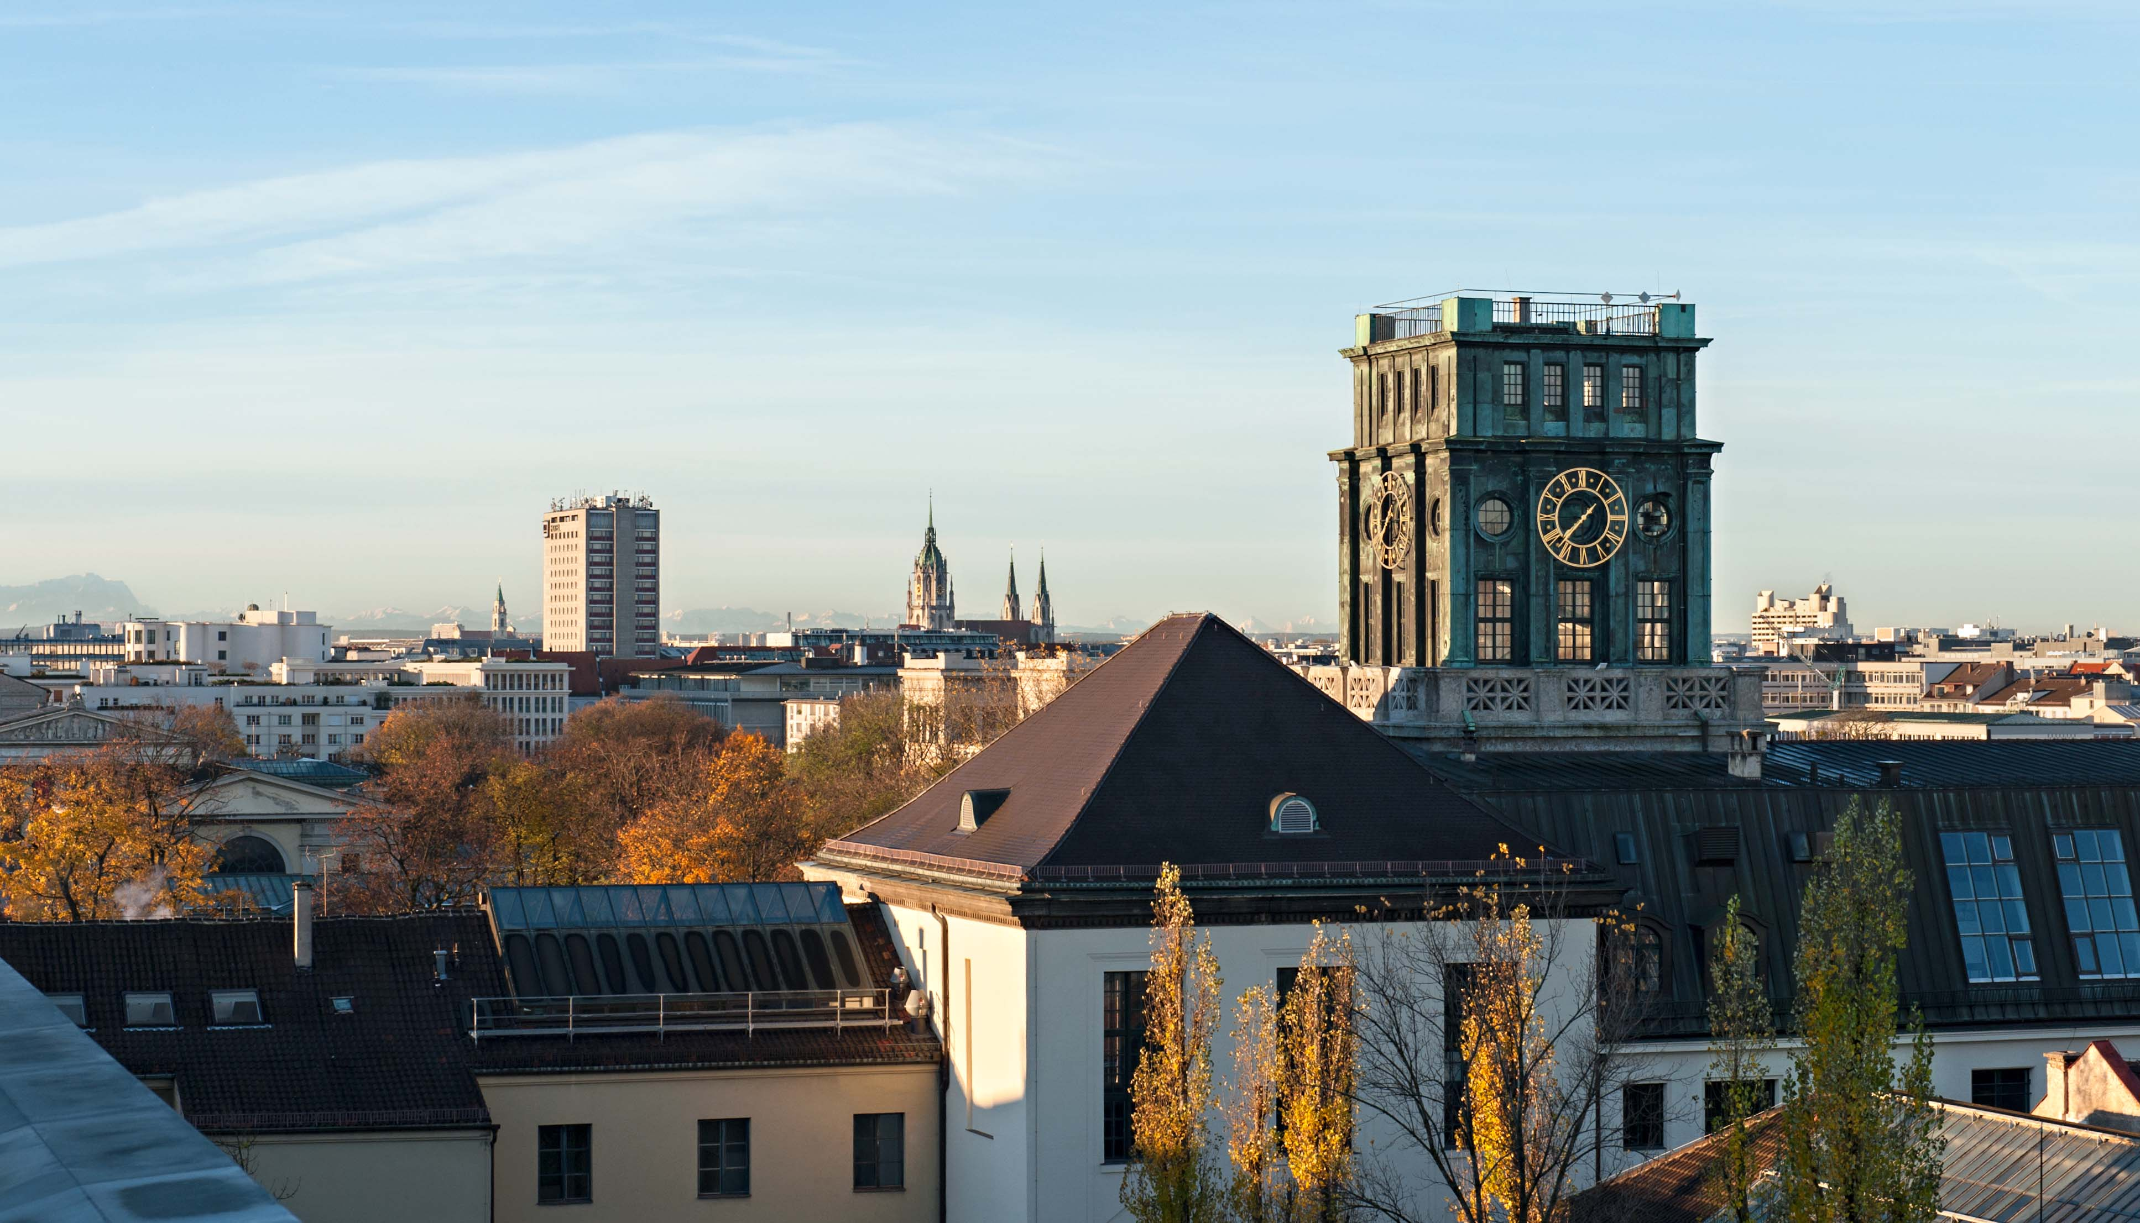

Pecha Kucha ²
The presentation from the group6

Slide 2
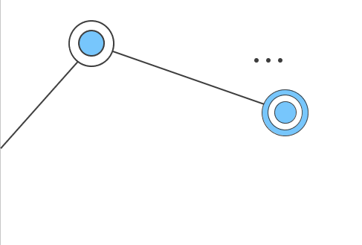

Contents
01
Image Preprocess
02
Model estimation
03
Model evaluation
04
Web
05
Git & Repository
06
Docker
07
Video/Report
2

Slide 3


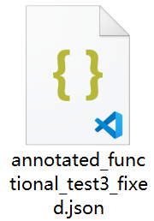
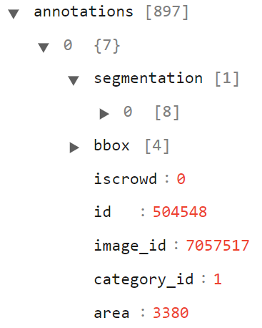

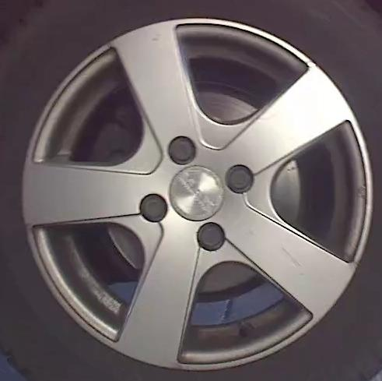


Image Preprocess
Image Preprocess
^{Dataset}
^{Fetch images}
Model estimation
Model evaluation
JSON file information analysis
Segmentation
Bbox
Image_id
Fetch annotated damaged area
Web
Git & Repository
Docker
Video/ Report
3

Slide 4


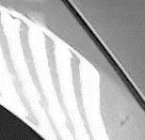
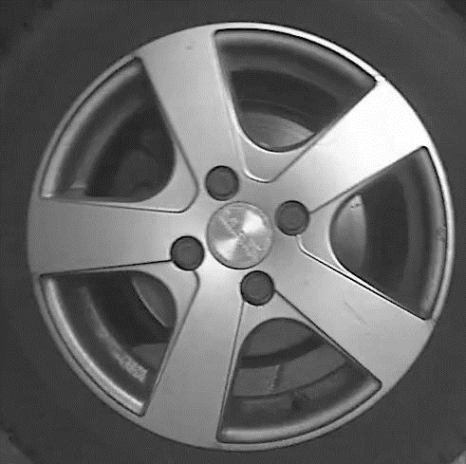


Image Preprocess
Image Preprocess
^{Generalization}
^{Preprocess}
Model estimation
Model evaluation
Images reshape to same size
Convert to gray images
Filter to remove noise
Web
Git & Repository
Docker
Video/ Report
4

Slide 5
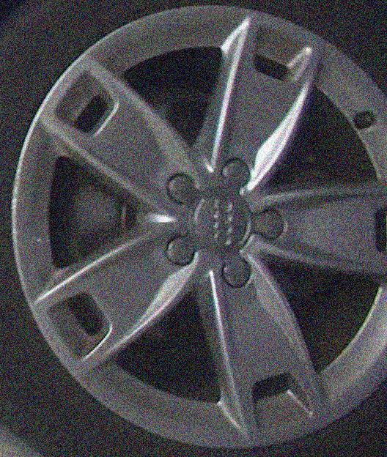
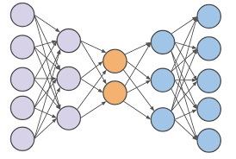

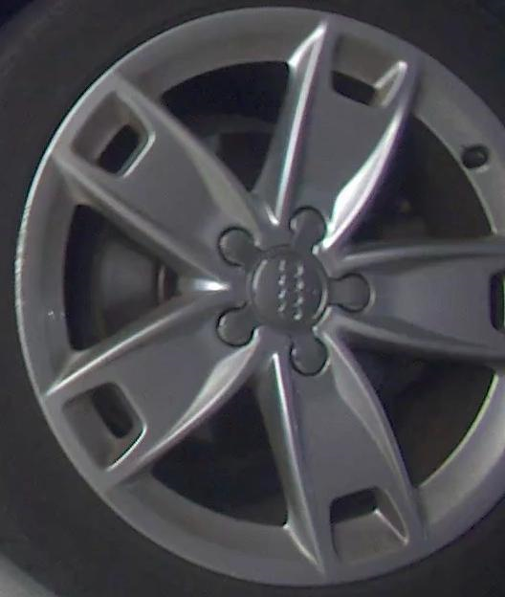

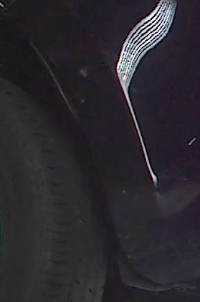
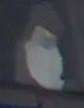
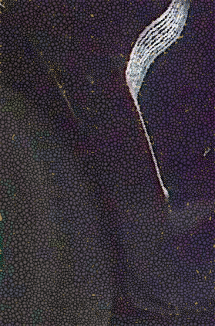
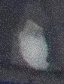
Model estimation
Image Preprocess
Autoencoder ^{[1]}
Classify damage into several categories
Reconstructed images
Model estimation
Model evaluation
Original images
Web
Git & Repository
Autoencoder architecture
training images without labels
→ minimize the error between reconstructed data and original data
Docker
[1] Rumelhart, D. E., Hinton, G. E., & Williams, R. J. (1985). Learning internal representations by error propagation. California Univ San Diego La Jolla Inst for Cognitive Science.
Video/ Report
5

Slide 6
Model estimation
Image Preprocess
Model estimation
After training with no label, remove decoder for classification:
Model evaluation
have already learned a latent feature
capture meaningful information
unsupervised learning model
Encoder
Z
Web
X
Git & Repository
Input
Latent Features
(lower dimension)
Docker
Video/ Report
6

Slide 7
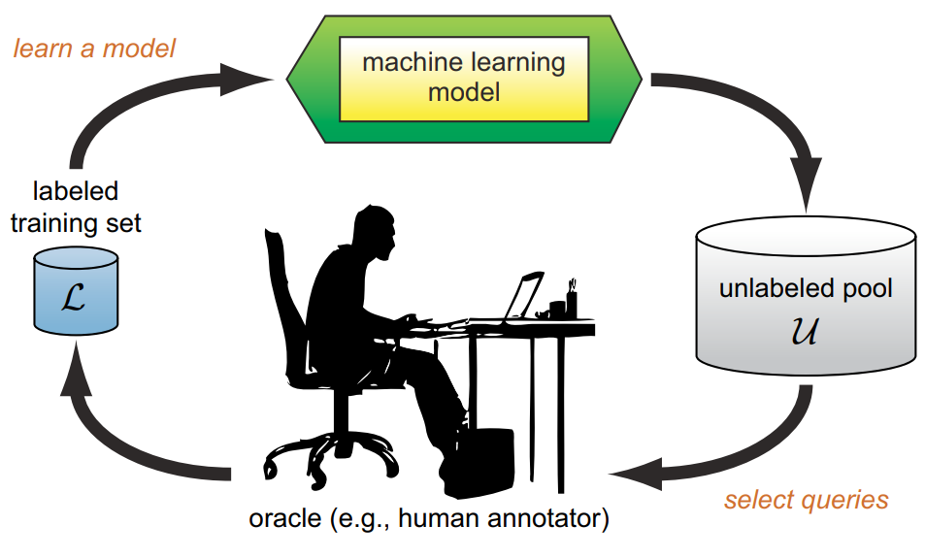
Model estimation
Image Preprocess
Active learning ^{[2]}
Small labeled data + large amounts of unlabeled data -> classification
Model estimation
Model evaluation
Web
Git & Repository
Docker
Video/ Report
[2] Settles, B. (2009). Active learning literature survey.
7

Slide 8
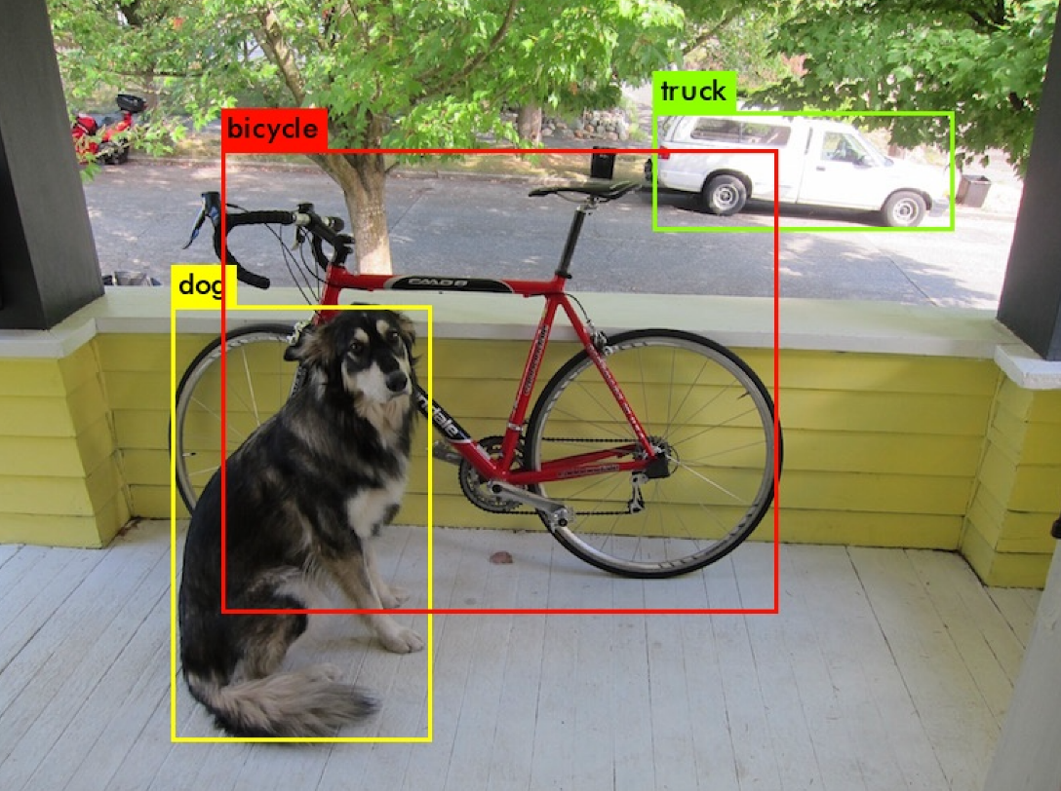
Model estimation
Image Preprocess
Yolo(You Only Look Once)^{[3]}
The algorithm with high speed and accuracy -> classification
Model estimation
Model evaluation
Web
Git & Repository
Docker
Video/ Report
[3] Bochkovskiy, A., Wang, C. Y., & Liao, H. Y. M. (2020). Yolov4: Optimal speed and accuracy of object detection. arXiv preprint arXiv:2004.10934.
8

Slide 9
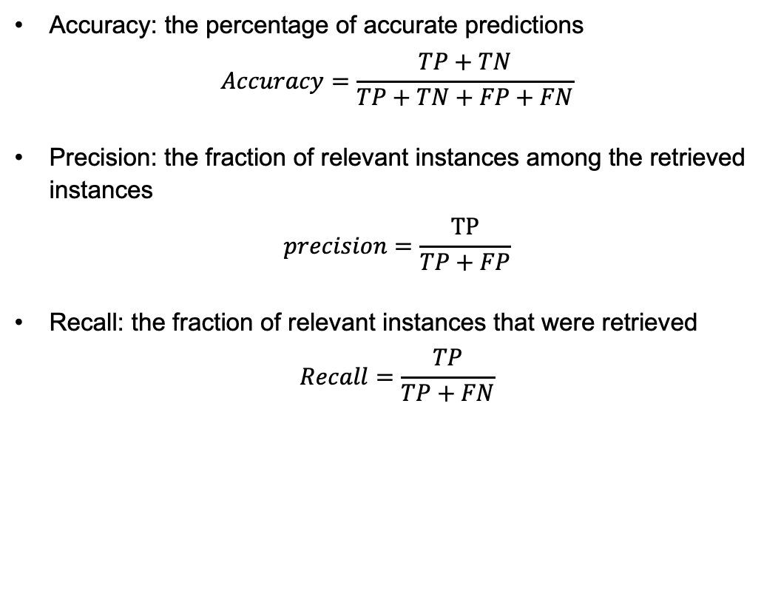
Model evaluation
Image Preprocess
Accuracy: the percentage of accurate predictions
$$Accuracy=\frac{TP+TN}{TP+TN+FP+FN}$$
Precision: the fraction of relevant instances among the retrieved instances
$$precision=\frac{TP}{TP+FP}$$
Recall: the fraction of relevant instances that were retrieved
$$Recall=\frac{TP}{TP+FN}$$
Model estimation
Model evaluation
Web
Git & Repository
Docker
Video/ Report
9

Slide 10
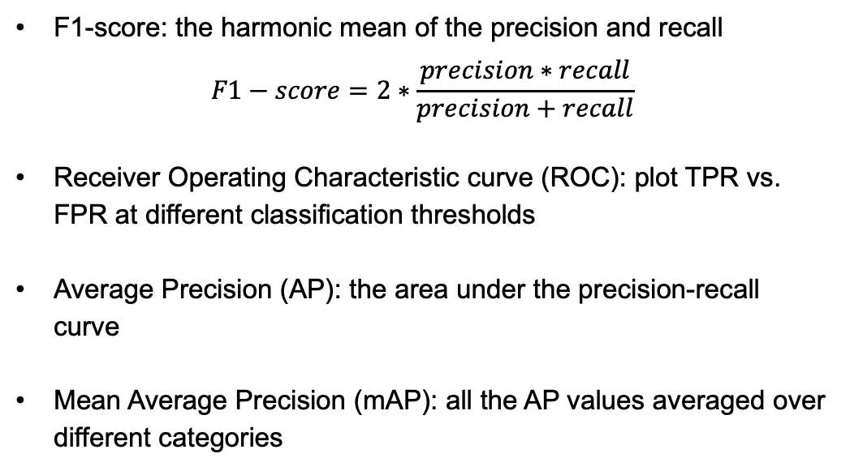
Model evaluation
Image Preprocess
F1-score: the harmonic mean of the precision and recall
$$F1−score=2∗\frac{precision∗recall}{precision+recall}$$
Receiver Operating Characteristic curve (ROC): plot TPR vs. FPR at different classification thresholds
Average Precision (AP): the area under the precision-recall curve
Mean Average Precision (mAP): all the AP values averaged over different categories
Model estimation
Model evaluation
Web
Git & Repository
Docker
Video/ Report
10

Slide 11
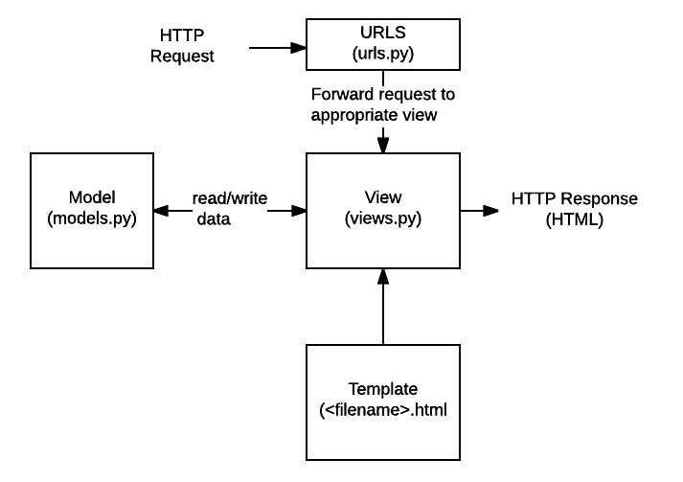

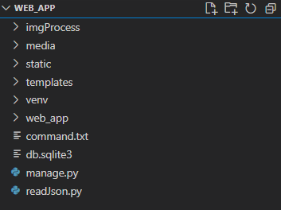
Web
Image Preprocess
Django Web Framework:
The web framework for perfectionists with deadlines !
Model estimation
Model evaluation
Web
Git & Repository
Docker
Video/ Report
11
Notes:
https://pythonistaplanet.com/advantages-of-django/
https://developer.mozilla.org/en-US/docs/Learn/Server-side/Django/Introduction#what_does_django_code_look_like
Django web applications typically group the code that handles each of these steps into separate files:

Slide 12


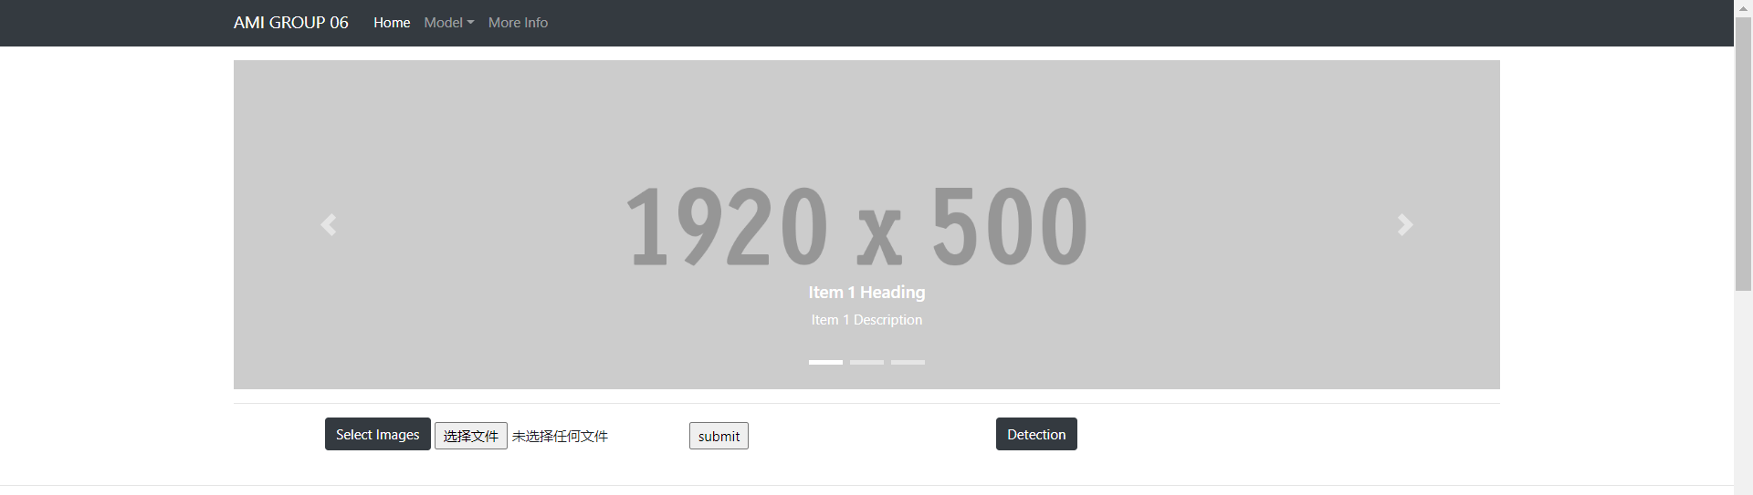
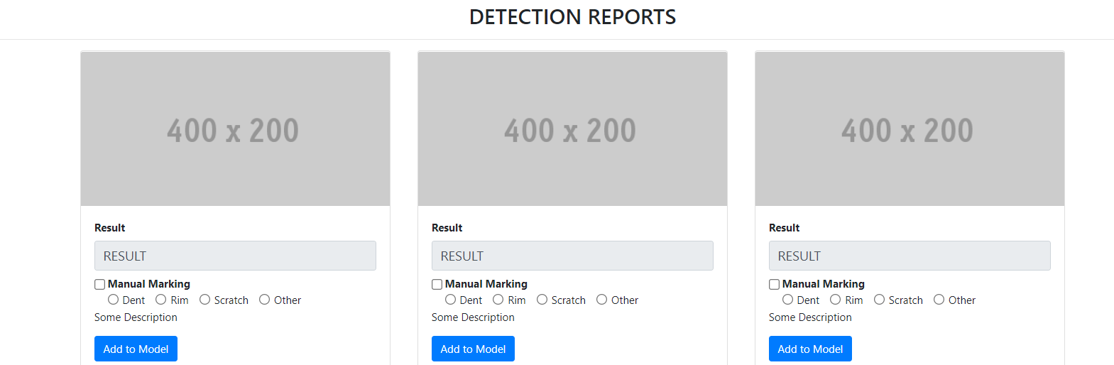
Web
Image Preprocess
WEB GUI Design & Implementation
Adobe Dreamweaver
Bootstrap
Model estimation
Model evaluation
Web
Git & Repository
Docker
Video/ Report
12
Notes:
https://medium.com/@VeRobin1/5-benefits-of-using-dreamweaver-for-web-designing-b2ce50fc2173
https://www.cybersuccess.biz/advantages-of-bootstrap/

Slide 13
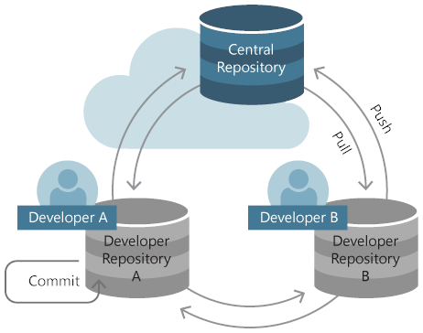
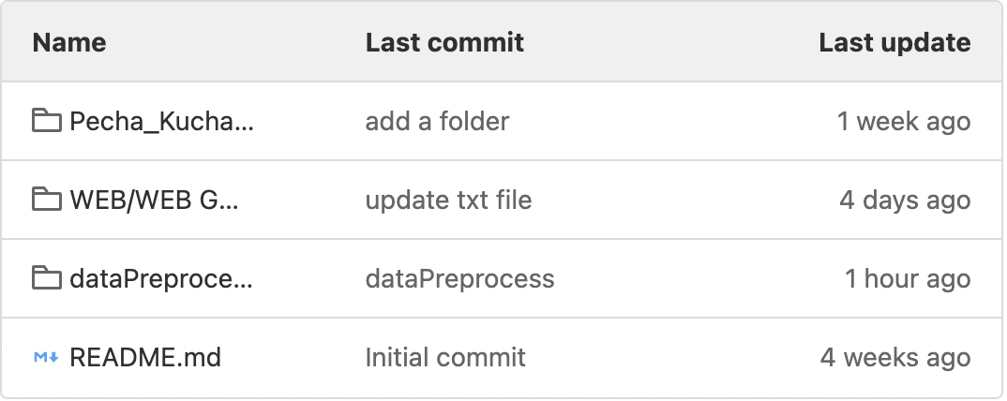

Git & Repository
Image Preprocess
Upload local files to git:
cd existing_repo
git remote add origin https://gitlab.ldv.ei.tum.de/ami2022/Group06.git
git branch -M master
git push -uf origin master
Model estimation
Model evaluation
Web
Already existing files in our group git:
Git & Repository
Docker
Video/ Report
13

Slide 14

Docker
Image Preprocess
Dockerfile
Model estimation
Creates a layer Docker image.
Install dependencies from Requirements.txt
Run the command
Model evaluation
Web
Git & Repository
Docker
Video/ Report
14

Slide 15
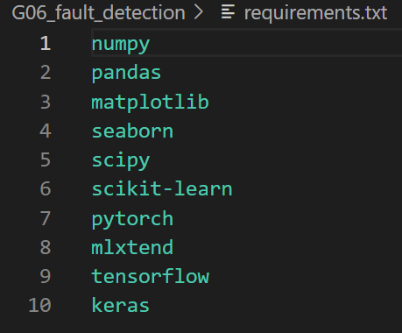
Docker
Image Preprocess
Dockerfile
Model estimation
Creates a layer Docker image.
Install dependencies from Requirements.txt
Run the command
Model evaluation
Requirements.txt
Prepare necessary python packages
Update Requirements.txt as needed
Team member unified package version
Web
Git & Repository
Docker
Video/ Report
15

Slide 16




Docker
Image Preprocess
Dockerfile
Model estimation
Creates a layer Docker image.
Install dependencies from Requirements.txt
Run the command
Model evaluation
Requirements.txt
Prepare necessary python packages
Update Requirements.txt as needed
Team member unified package version
Web
Docker-compose.yml
Git & Repository
Set frontend and backend Container
access via port 8888
Docker verification once every 3 weeks
Docker
Docker-Compose
Video/ Report
16

Slide 17
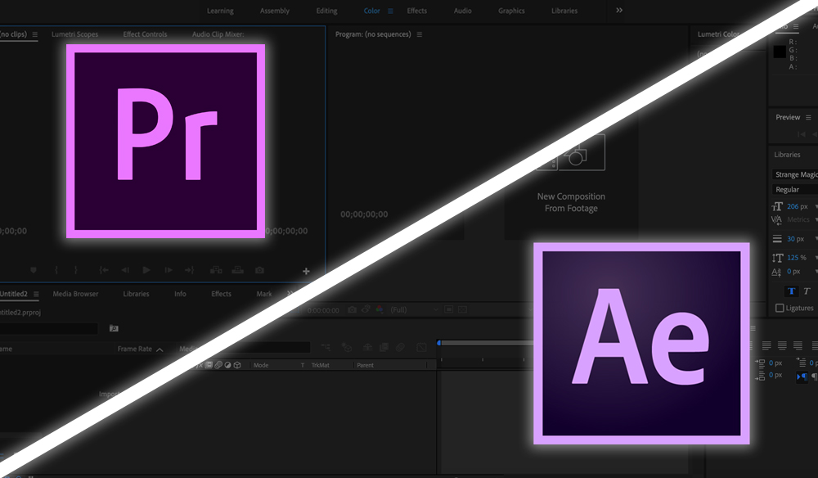
Video/ Report
Image Preprocess
Model estimation
Model evaluation
Web
Git & Repository
Docker
Video/ Report
17

Slide 18
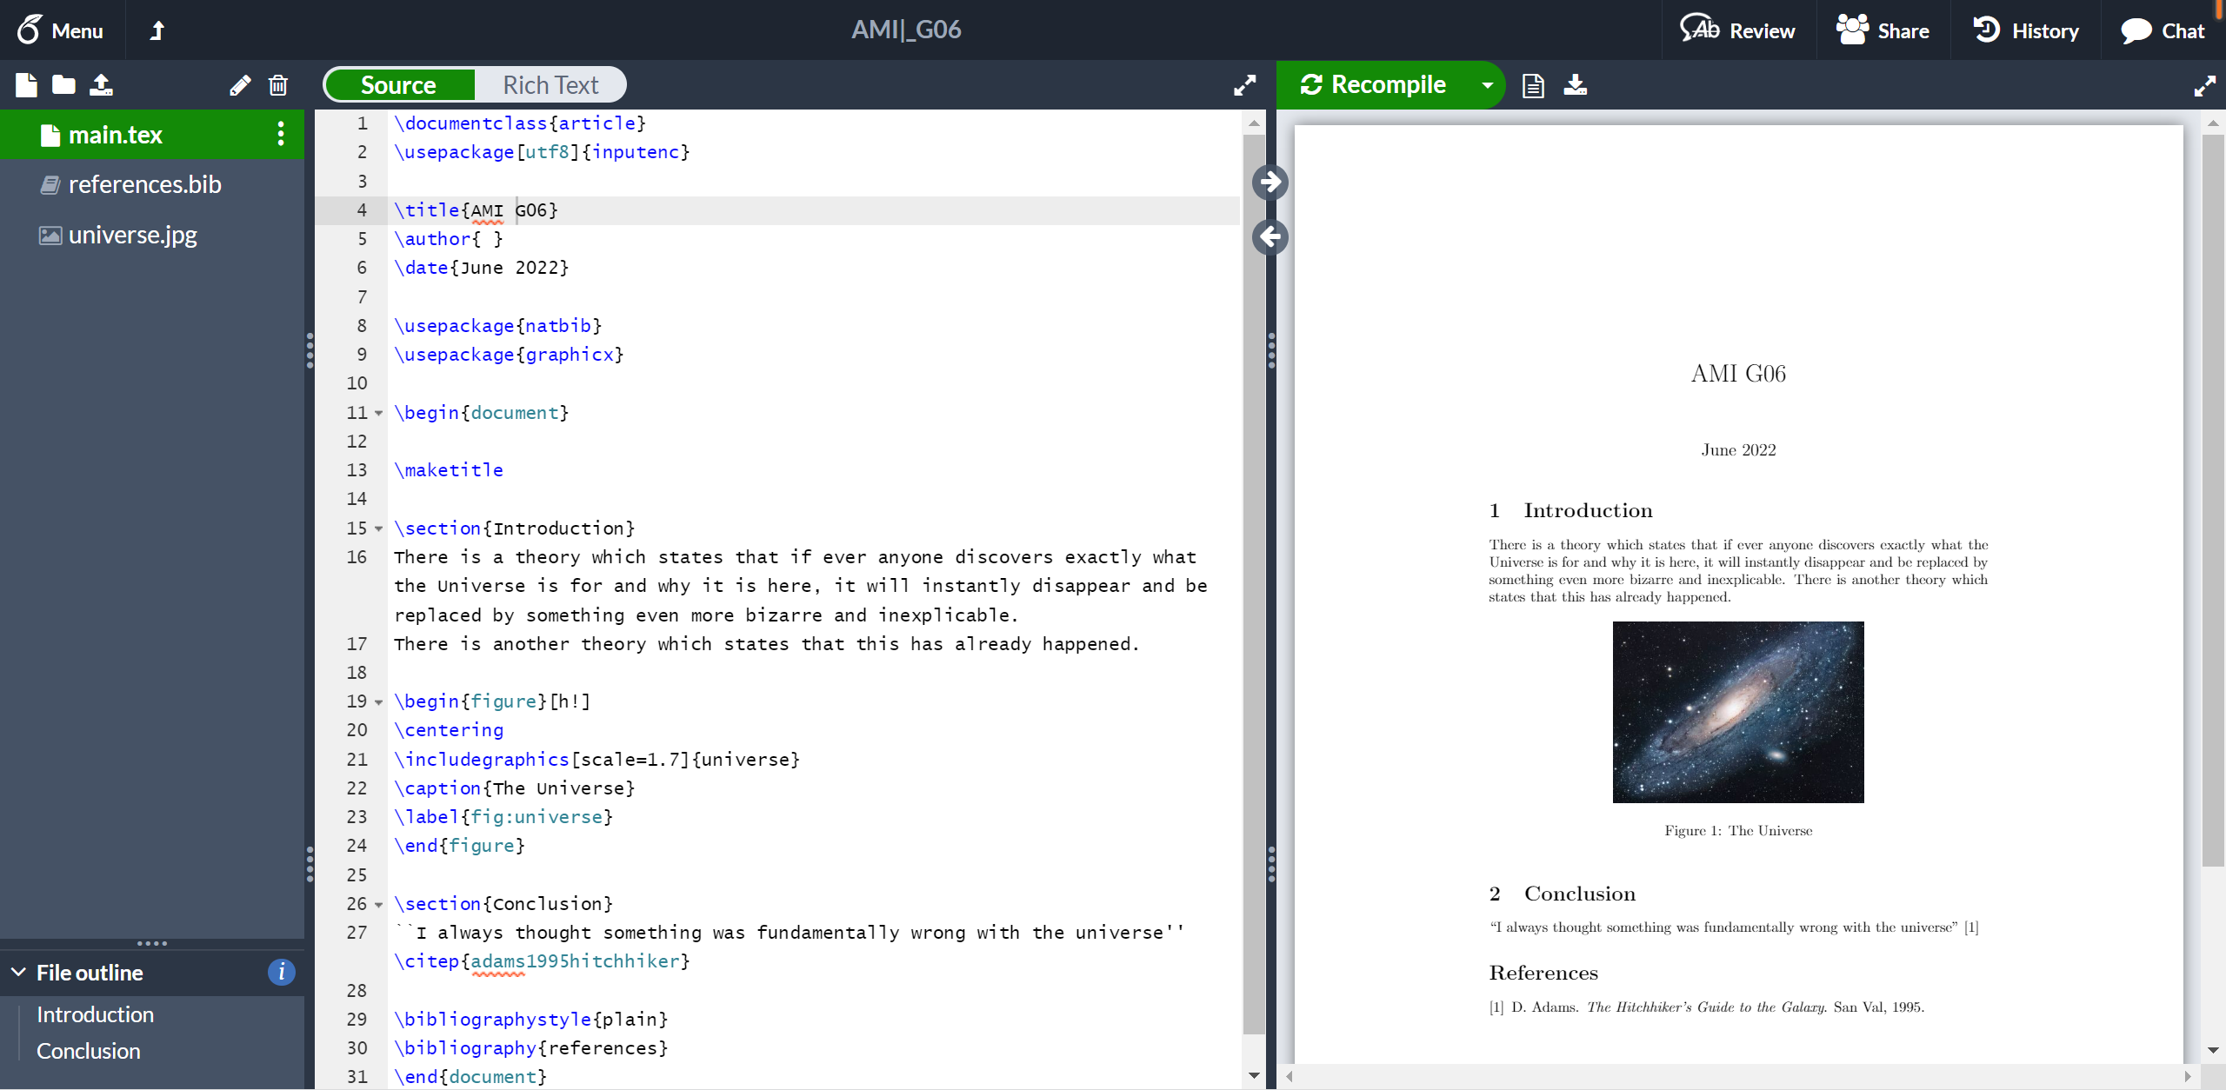

Video/ Report
Image Preprocess
Model estimation
Model evaluation
Web
Git & Repository
Docker
^{https://latex.tum.de}
Video/ Report
18

Slide 19
Image Preprocess
Team Cooperation & Work in Progress
Model estimation
Model evaluation
Web
Git & Repository
Docker
Video/ Report
19

Slide 20
Thank you
FOR YOUR ATTENTION
Source: https://stock.adobecom/

